Slide 1
Uniform and Equipment at Bristol Free School

Slide 2
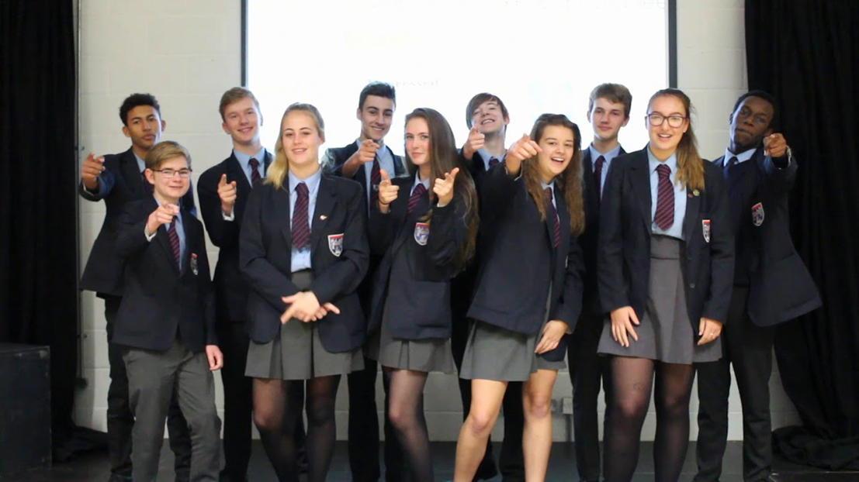
At Bristol Free School the principle of a uniform is to:
• Mark the formality of being educated at Bristol Free School
• Reinforce a sense of shared membership and pride in our School felt by all members of the community

Slide 3
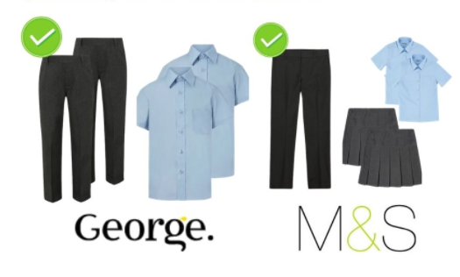
Uniform
Uniform can be purchased through The Famous Schoolwear Specialists
You can order items through their website:
https://www.monkhouse.com/c/4130/Bristol-Free-School
Monkhouse Parent Guice can be found here: https://www.monkhouse.com/parentguide
OR contact one of their 3 Bristol stores to book an appointment:
Stoke Gifford: BS34 8HR, 0117 962 0011
Bedminster: 140 East Street, BS3 4EW 0117 966 1432
Yate: Unit 4A Badminton Centre, BS37 5HT 01454 323779 There is a tab on our website for information on uniform: https://www.bristolfreeschool.org.uk/uniform.php
Trousers and shirts can be bought at a supermarket – they need to be charcoal and light blue
All items should be clearly named

Slide 4
Uniform
Tie – must be worn neatly and at a sensible length
Jumper – navy blue V-neck jumper with or without the BFS logo (this is optional!)
Trousers – girls may wear school trousers or a pleated mid-grey skirt (no higher than 5cm above the knee) with either tights or socks (tights must be opaque black or navy, without any pattern)
Headscarf – navy blue (optional)
Socks – black or charcoal with no pattern with trousers / short white or knee length charcoal with skirts
Footwear – all black leather, low-heeled, polishable shoes with no discernible branding / logos.
Coats / outerwear – Plain and standard school style – no denim or leather and no commercial logos. No hooded tops. Coats are not a replacement for blazers.
Jewellery – watch and a maximum of one plain silver or gold stud per earlobe. No other forms of body piercing or jewellery.
Make up – discreet foundation is permitted but nothing else. No nail varnish or artificial nails.
Hairstyle – standard school style (no extreme colours or cuts)
School bags – rucksacks only (large enough to contain school equipment with no commercial logos) – handbags, shoulder bags and satchels are not allowed

Slide 5
PE Kit
Compulsory:
Polo shirt*: Short sleeve, navy/red with BFS logo Shorts/Skort: Plain navy blue
Trainers: Sports trainers with non-marking sole
Socks: Plain navy-blue knee length
Shin pads Gumshield
Recommended:
Boots for football/rugby
Optional:
Trousers/Joggers: Plain navy blue (no logos)
Sweatshirt: Navy/red ¼ zip sweatshirt*, or
plain navy pullover jumper (no zip, no hood, no logos)
Base layer: Plain navy blue
BFS rugby shirt*: Long sleeve, navy/red
Compulsory for Extra-Curricular Sport:
Shin pads – football.
Gum shield – rugby.
Boots – football and rugby.

Slide 6
Equipment

Slide 7
If you have any further questions / queries…
For all general school queries, please contact:
admin@bristolfreeschool.org.uk
For any transition-specific queries, please contact:
transition@bristolfreeschool.org.uk

